Slide 1

Programming Fundamentals
Lecture # 9
Ehtisham Rasheed
Department of Computer Science
University of Gurjat, Gujrat

Slide 2
Problem 1
Write a program that asks the user to enter two numbers, obtain two numbers from user and prints the sum, product, difference and quotient of two numbers.

Slide 3



Problem 2
Write a program that reads in the radius of a circle as an integer and print the circle’s diameter, circumference and area. Use constant value 3.14159 for . Use following formulas
Area of circle:
Circumference of circle:

Slide 4
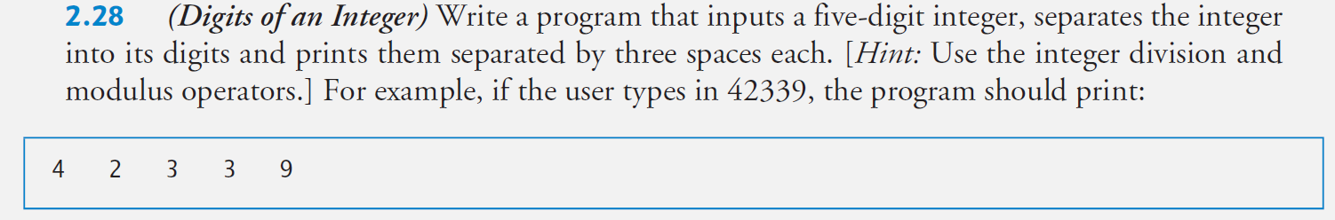
Problem 3

Slide 5
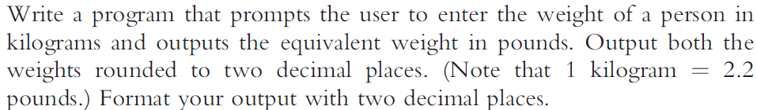
Problem 4

Slide 6

Problem 5
Write a program that input temperature in Fahrenheit and show temperature in Celsius degree. Use following formula for conversion:

Slide 7
Problem 6
Write a program to enter time from user in format hh:mm:ss. Then show time in seconds.

Slide 8
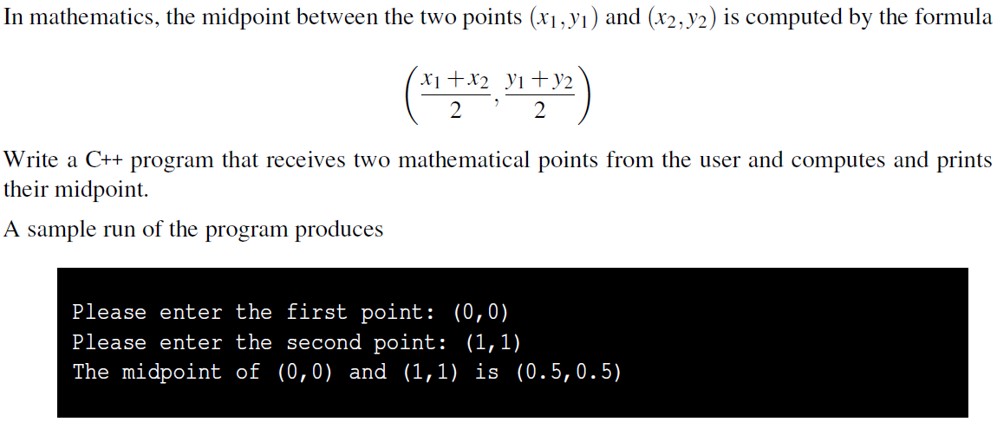
Problem 7

Slide 9
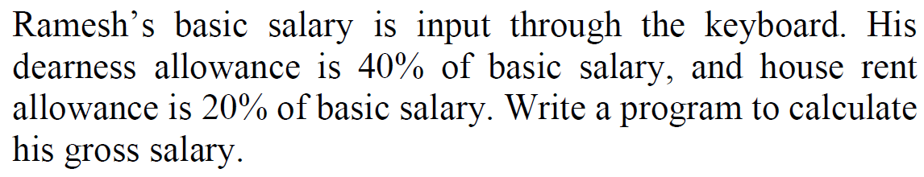
Problem 8

Slide 10
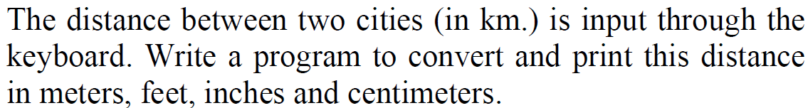
Problem 9
1 KM = 1000 M
1 KM = 3280.84 feet
1 KM = 39370.1 Inch
1 KM = 100000 cm

Slide 11
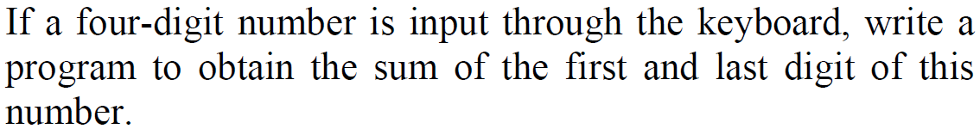
Problem 10

